Slide 1
Modern Cloud Apps
Danang SW

Slide 2
Abstract and learning objectives
Abstract
You will be challenged to implement an end-to-end scenario using a supplied sample that is based on Azure App Services, Microsoft Azure Functions, Azure SQL Database, Azure Logic Apps, and related services.
Learning objectives
Deploying and configuring Azure Web Apps
Automating back-end services using Azure Functions and Logic Apps
Instrumenting and load-testing applications with App Insights
Notes:
This is an introduction to the Cloud Workshop at a high level. Later we’ll get into customer objections, requirements, etc… but we want to ground the participants on the business outcomes we’re going after for the day.

Slide 3
Step 1: Review the customer case study
Outcome
Analyze your customer needs.
Timeframe
15 minutes

Slide 4

Customer situation
Contoso Sports League Association is one of the largest sports franchises
Run a highly successful e-commerce website
Backend website supports call center
Notes:
The Contoso Sports League Association (CSLA) is one of the largest sports franchises.
They run a highly successful e-commerce website that sells merchandise to their legions of sports fans.
This website is built using ASP.NET
Currently hosted in a co-lo.
They also have a backend website that supports their call center. Call center employees use this admin website to view customer orders.
They accept payment by credit card, and owing to their high annual volume (in the tens of millions, processing about 50K per day) of transactions, need to ensure that they are PCI DSS Level 1 compliant.
Their website hosts the shopping cart and checkout process
They defer the credit card authorization and capture responsibilities of the credit card processing to a third-party payment gateway.
This payment gateway provides a web API that is invoked over TLS from Contoso server side logic.
The call includes the credit card holder data (name, number, etc.) and returns a status indicating a success or failure in authorizing and capturing payment against the credit card.

Slide 5

Customer needs
Move infrastructure to PaaS solutions
Ensure data privacy and protection
Scale API independently of website
Provide failover mechanism
Notes:
Manage their server infrastructure, which is becoming a real challenge. Contoso is interested in understanding more about PaaS solutions.
Maintain existing PCI compliance.
Assure data privacy and protection across all aspects of the system; in transit and at rest.
Make architectural decisions that help to minimize engineering around infrastructure in favor of those that deliver core business value.
Ensure that they retain their core functionality, even if the way it is accomplished under the covers might change.
Provide a better solution for the management of usernames and passwords.

Slide 6
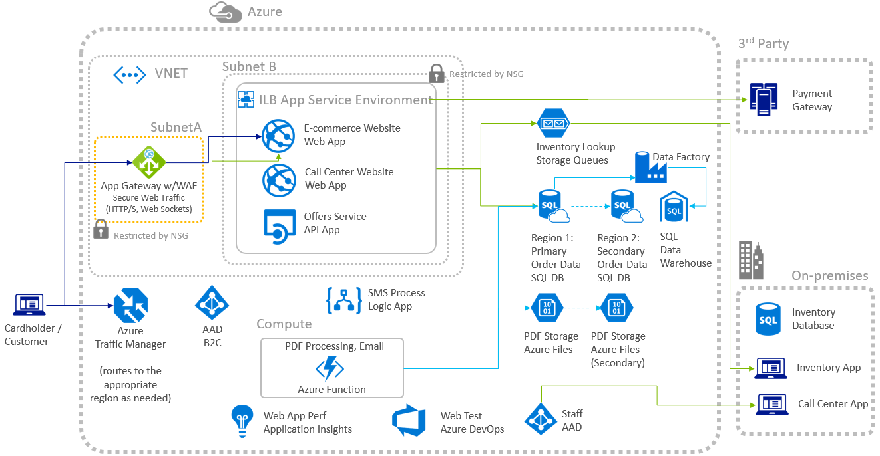
Preferred solution
Notes:
This preferred solution is just one of many viable options
From a high-level:
Web Apps hosting the e-commerce and call center websites,
API Apps hosting web services
Logic Apps hosting integration with SMS
Azure Traffic Manager is used for routing to the appropriate region for high availability
The Web and API Apps can be hosted within an Internal Load Balanced (ILB) App Service Environment (ASE) that enables them to take advantage of Network Security Groups to lock down inbound and outbound communication to the App Services it hosts
Web Application Firewall (WAF) provided by an Azure App Gateway is hosted in its own subnet and NSGs. Internet traffic flows through the WAF to the e-commerce website that’s hosted within the ASE, which only allows inbound traffic from the WAF.
When customers visit the website, they are presented featured products on offer whose data comes from the Offers Service REST API hosted within an API App.
Orders come in from customers via the publicly accessible endpoint of the e-commerce website.
Credit card is validated as a part of the checkout process by making a call to a third-party payment gateway.
Once authorized and payment is captured, the order data is stored in the orders database on SQL DB and the inventory lookup message is sent to the Inventory Lookup queue.
An Azure Function is used for creating the PDF receipts for customer purchases.
Customers are notified via SMS as their order is processed, via a process running in a Logic App that integrates the SQL DB with a third-party solution for sending SMS text messages.
Inventory lookup requests are queued from the e-commerce website to the queue in Azure Storage queues. The on-premises inventory app reads from this queue to kick off its internal lookup processes and writes the status back to the orders database.
Call center operators access the call center website which, owing to the NSGs configured, is only available across the virtual private network (VPN) connection.

Slide 7
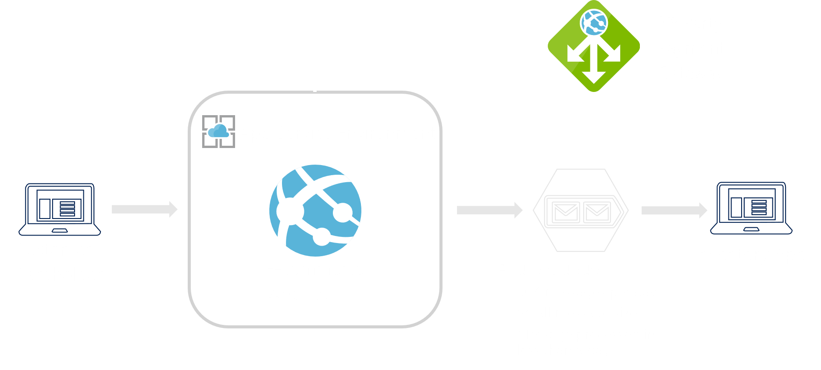
Preferred solution
Order fulfillment
Notes:
How would you recommend CSLA manage the inventory lookup queues? How would you help CSLA decide between Azure Queues and Service Bus? Be sure to consider details implied by SLA’s requirements such as volume, message lifetime and sizing. Explain the details of any computations you make.
No specific asks implying need for Service Bus features
Low volume of 50k per day (Queues supports 2k per second)
Small messages sizes
Messages processed in less than a day
Consider Azure Queues

Slide 8

Preferred solution
Notifications
Use Logic App
Frequency trigger executes stored procedure
Notes:
How would you recommend CSLA manage notifying customers as their order in the CSLA orders database is processed?
A logic app with:
a frequency trigger to execute a stored procedure at an interval that will identify orders that should receive SMS notifications and update them as processed.
a Twilio Connector could act as the action to perform that sends the SMS message when the frequency trigger executes the stored procedure.

Slide 9

Preferred solution
Offers Service
Migrate to Azure App Service API App
Enable CORS
Consider API Management
Notes:
How would you propose Contoso meet their requirements for the Offers service?
Migrate to Azure App Service API App
What specific configurations would you need to make to support your proposed topology?
Need to enable CORS in:
API App
Web API code
Also consider suggesting future API Management as a feature for Contoso to support partner integrations.
Enable lock down access by requiring a key, apply policy (such as rate limiting requests), and monitor usage by API customer

Slide 10
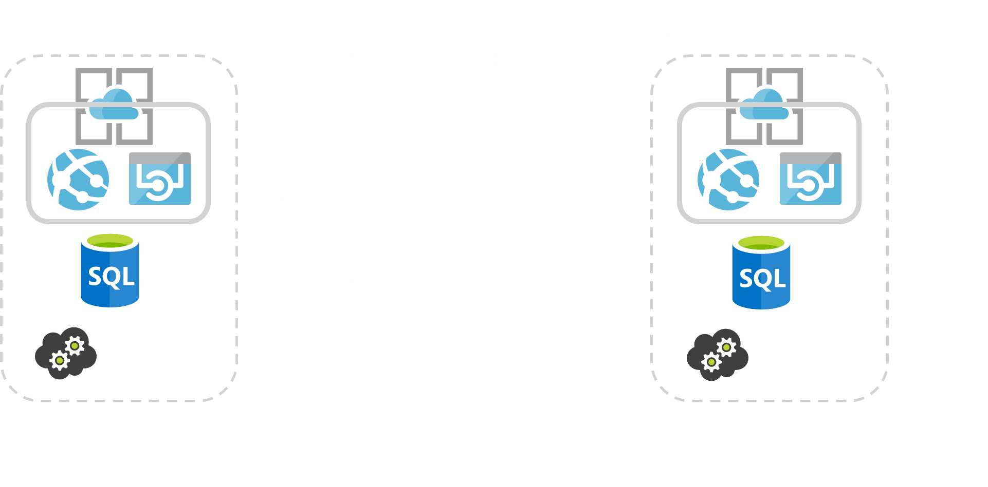
Preferred solution
Geo-resiliency
Notes:
How would you implement high availability for the orders database to guard against regional data center outages?
Use Active Geo-Replication to up to four other databases on different servers in different regions.
Provision the Azure Storage Account with RA-GRS redundancy (matching the regions used by SQL DB).
Deploy copies of the App Services and Cloud Services to the backup regions.
When using auto-failover groups (in-preview) to manage database recovery and any outage that impacts one or several of the databases in the group results in automatic failover.
How long would a failover take and how much data could be lost, in terms of time?
The amount of time a failover takes is the Recovery Time Objective (RTO) The amount of data loss that might transpire due to any replication latency is the Recovery Point Objective (RPO).
For SQL Database on the Premium tier, the RTO is less than 30 seconds and the RPO is less than 5 seconds.
For Azure Storage, the RTO is about 24 hours and the RPO is typically less than 15 minutes (though this has no explicit SLA).
Given the potentially long RTO and RPO for Azure Storage, Contoso should consider using RA-GRS storage and when a failover happens use the RA-GRS for read and a separate storage account for the writing of new files.

Slide 11
Proof of concept deployment
Contoso has asked you to create a proof of concept deployment in Microsoft Azure by deploying the web, database, and API applications for the solution as well as validating that the core functionality of the solution works.

Slide 12
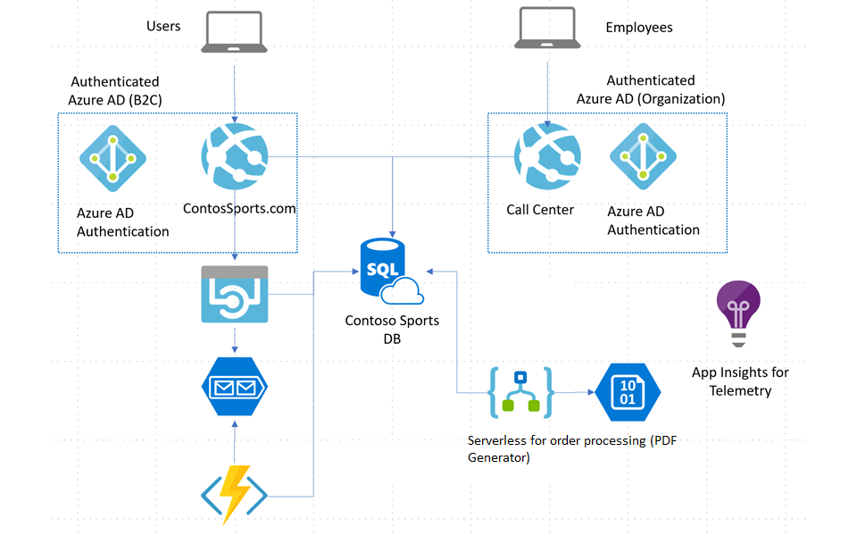
Solution architecture

Slide 13
Requirements
Microsoft Azure subscription
Local machine or a virtual machine configured Visual Studio 2017 Community Edition

Slide 14
Azure services
App Service Environment
Web App
API App
Azure Functions
Azure Storage
Azure Storage Queues
Azure SQL Database
Azure Logic Apps
Azure Insights

Slide 15
Exercise 1: Deploy the Web App & API services
Timeframe
180 minutes
Tasks
Task 1: Deploy the e-commerce website, SQL Database, and storage
Task 2: Setup SQL Database Geo-Replication
Task 3: Deploying the call center admin website
Task 4: Deploying the payment gateway
Task 5: Deploying the offers Web API
Task 6: Update and deploy the e-commerce website

Slide 16
Exercise 2: Enabling Telemetry with Application Insights
Timeframe
120 minutes
Tasks
Task 1: Configure the application for telemetry
Task 2: Creating the web performance test and load test

Slide 17
Exercise 3: Automating backend processes
Timeframe
120 minutes
Tasks
Task 1: Create an Azure Function to Generate PDF Receipts
Task 2: Create an Azure Logic App to Process Orders

Slide 18
THANKS

